Slide 1

CPU Scheduling for Virtual Desktop Infrastructure
PhD Defense
Hwanju Kim
2012-11-16

Slide 2


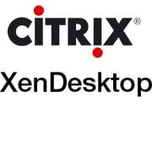

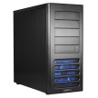




Virtual Desktop Infrastructure (VDI)
Desktop provisioning
Dedicated workstations
VM-based shared environments
VM
VM
VM
VM
VM
Energy wastage by idle desktops
Resource underutilization
High management cost
High maintenance cost
Low level of security
+ Energy savings by consolidation
+ High resource utilization
+ Low management cost
(flexible HW/SW provisioning)
+ Low maintenance cost
(dynamic HW/SW upgrade)
+ High level of security
(centralized data containment)

Slide 3
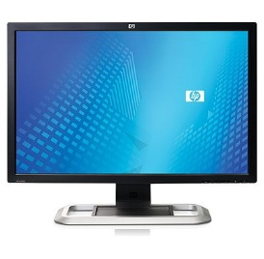

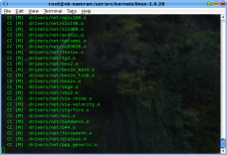
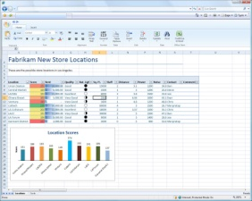
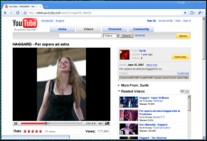



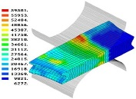
Desktop Consolidation
Distinctive workload characteristics
High consolidation ratio
4:1~15:1 [VMware VDI], 6~8 per core [Botelho’08]
Diverse user-dependent workloads
Light users and knowledgeable workers coexist
Multi-layer mixed workloads
Multi-tasking (interactive+background) in a consolidated VM
Mixed
Interactive
VM
VM
VM
VM
VM
VM
VM
VM
VM
CPU-intensive
Virtual Machine Monitor (VMM)
Parallel
Hardware

Slide 4
Challenges on CPU Scheduling
Challenges due to the primary principles of VMM, compared to OS scheduling research
3. Inter-VM fairness
(← Performance isolation)
: Favoring a VM must not compromise inter-VM fairness
Process and thread information
Inter-process communications
I/O operations and semantics
System calls
etc…
VM
VM
VM
Task
Task
Task
Task
Task
Task
Task
Task
I believe I’m on a dedicated machine
OS scheduler
OS scheduler
OS scheduler
1. Semantic gap
(← OS independence)
: Two independent
scheduling layers
vCPU
vCPU
vCPU
vCPU
vCPU
2. Scarce Information
(← Small TCB)
: Difficulty in extracting
workload characteristics
VMM
VMM scheduler
Each VM is virtualized as a black box
pCPU
pCPU
I/O operations
Privileged instructions
Lightweightness
(No cross-layer optimization)
Efficiency
(Intelligent VMM)

Slide 5


The Goals of This Thesis
The enlightened CPU scheduling of VMM for consolidated desktops
Efficient CPU management with lightweight VMM extensions
VM
VM
VM
VM
Communicating
workload
Background workload
Interactive
workload
Enlightening about
diverse workload
demands inside a VM
Thread
Thread
Thread
Thread
Thread
Thread
Thread
Thread
vCPU
vCPU
vCPU
vCPU
Base: CPU bandwidth
partitioning for
performance isolation
VMM
VMM scheduler
Design principles
OS-independence: VMM-level solutions without OS-dependent optimizations
Diversity: Identifying the computing demands of diverse workloads (including mixed workloads)
Inter-VM fairness: Performance isolation for multi-tenant environments

Slide 6
Related Work
Proposals |  | References | Design principles
 |  |  | OS- independence | Diversity | Inter-VM fairness
Proportional-share scheduling |  | Xen, KVM, VMware ESX | O | X | O
Interactive & soft real-time scheduling |  | [Lin et al., SC’05] [Lee et al., VEE’10] [Masrur et al., RTCSA’10] | O | X (User-directed, no mixed & communicating workloads) | X
OS-assisted scheduling |  | [Kim et al., EuroPar’08] [Xia et al., ICPADS’09] | X (OS-dependent optimization) | X (No communicating workloads) | O
I/O-friendly scheduling |  | [Govindan et al., VEE’07] [Ongaro et al., VEE’08] [Liao et al., ANCS’08] [Hu et al., HPDC’10] | O | X (Only I/O-intensive workloads) | O
Multiprocessor VM scheduling | Relaxed coscheduling | [VMware ESXi’10] [Sukwong et al., EuroSys’11] | O | X (No mixed workloads) | O
 | Spinlock-aware scheduling | [Uhlig et al., VM’04] [Weng et al., HPDC’11] | X (OS-dependent optimization) | X (Only spinlock-intensive workloads) | O
 | Hybrid scheduling | [Weng et al., VEE’09] | O | X (User-involved, no mixed workloads) | O

Slide 7
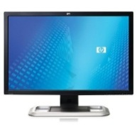

Overview
Proposal
Defense
Introduction to “Task-aware VM scheduling”
[Kim et al., VEE’09], [Kim et al., JPDC’11]
+ The first solution to mixed workloads in a consolidated VM
+ Simple and effective for I/O-bound interactive workloads
- No consideration about multiprocessor VMs
- Lacking ability to support modern interactive workloads
VM
VM
VM
Extension
User-Interactive
workload
Background workload
I/O-bound task
CPU-bound task
CPU-bound task
CPU-bound task
“Virtual
asymmetric
multiprocessor”
Task-based
Priority boosting
Multithreaded
(communicating or parallel)
workload
vCPU
vCPU
VMM
“Demand-based
coordinated
scheduling”
Thread
Thread
VMM scheduler
Thread
Thread
pCPU
vCPU
vCPU
vCPU
vCPU
Implementation
Proposal for multiprocessor VM scheduling
→ Efficient scheduling for multithreaded workloads
hosted on multiprocessor VMs
VMM
VMM scheduler
pCPU
pCPU
pCPU
pCPU

Slide 8
Demand-Based Coordinated Scheduling for Multiprocessor VMs
VM
Multithreaded
(communicating or parallel)
workload
Thread
Thread
Thread
Thread
vCPU
vCPU
vCPU
vCPU
VMM
VMM scheduler
How to effectively schedule multithreaded workloads hosted in multiprocessor VMs?
pCPU
pCPU
pCPU
pCPU

Slide 9

Why Coordinated Scheduling?
Uncoordinated vs. Coordinated scheduling
Uncoordinated scheduling
Each vCPU is treated as an independent entity
regardless of its sibling vCPUs
Coordinated scheduling
Sibling vCPUs are coordinated by VMM scheduler
vCPU
vCPU
vCPU
vCPU
vCPU
vCPU
vCPU
vCPU
Time
shared
Independent
entity
vCPU
vCPU
vCPU
vCPU
Time
shared
vCPU
vCPU
vCPU
vCPU
vCPU
vCPU
vCPU
vCPU
vCPU
vCPU
vCPU
vCPU
VMM
Coordinated
group
VMM
VMM scheduler
VMM scheduler
pCPU
pCPU
pCPU
pCPU
pCPU
pCPU
pCPU
pCPU
Why is coordination needed?
Many applications are multithreaded and parallelized
Multiple threads perform a job communicating with
each other to arbitrate accesses to shared resources
vCPU
Inactive
Lock holder
vCPU
Time
shared
Inactive
Lock waiter
vCPU
Similar to traditional job scheduling
issues in distributed environments
Multicore resembles a distributed environment
Active
Lock waiter
Uncoordinated scheduling makes
inter-thread communication ineffective

Slide 10
Coordination Space
Space and time domains
Space domain
pCPU assignment policy
Where is each sibling vCPU assigned?
Time domain
Preemptive scheduling policy
When and which sibling vCPUs are preemptively scheduled
e.g., Co-scheduling
Time
When to schedule?
vCPU
vCPU
vCPU
vCPU
vCPU
vCPU
vCPU
vCPU
Coordinated
group
vCPU
vCPU
vCPU
vCPU
pCPU
pCPU
pCPU
pCPU
Space
Where to schedule?

Slide 11
Space Domain: pCPU Assignment
A naïve method
“Balance scheduling”[Sukwong et al., EuroSys’11]
Spread sibling vCPUs on separate pCPUs
Probabilistic co-scheduling due to
the increase of likelihood of coscheduling
No coordination in time domain
Limitation
An unrealistic assumption: “CPU load is well balanced”
In practice, VMs with equal CPU shares have
Different number of vCPUs
Different thread-level parallelism
Phase-changed multithreaded workloads
vCPU
vCPU
vCPU
vCPU
vCPU
vCPU
vCPU
vCPU
vCPU
vCPU
vCPU
vCPU
pCPU
pCPU
pCPU
pCPU
Highly contended
Larger
CPU shares
vCPU
vCPU
vCPU
vCPU
vCPU
vCPU
pCPU
pCPU
pCPU
pCPU

Slide 12
Space Domain: pCPU Assignment
Proposed scheme
“Load-conscious balance scheduling”
Hybrid scheme of balance scheduling & load-based assignment
If all candidate pCPUs are not overloaded,
balance scheduling
Otherwise,
load-based assignment
vCPU
vCPU
vCPU
vCPU
vCPU
vCPU
vCPU
vCPU
vCPU
vCPU
vCPU
vCPU
vCPU
vCPU
vCPU
vCPU
vCPU
vCPU
pCPU
pCPU
pCPU
pCPU
pCPU
pCPU
pCPU
pCPU
Example
Candidate pCPU set
(Scheduler assigns a lowest-loaded pCPU in this set)
vCPU
vCPU
vCPU
= {pCPU0, pCPU1, pCPU2, pCPU3}
Wait queue
vCPU
How about contention
between sibling vCPUs?
vCPU
vCPU
vCPU
pCPU3 is overloaded
(i.e., CPU load > Average CPU load)
→ Pass to coordination in time domain!
pCPU0
pCPU1
pCPU2
pCPU3

Slide 13

Time Domain: Preemption Policy
What type of contention demands coordination?
Busy-waiting for communication (or synchronization)
Unnecessary CPU consumption by busy-waiting for a descheduled (inactive) vCPU
Significant performance degradation
Why serious in multiprocessor VMs?
Semantic gap
OSes make liberal use of busy-waiting (e.g., spinlock) since they believe their vCPUs are always online (i.e., dedicated)
“Demand-based coordinated scheduling”
Issues
When and where to demand coordination?
Busy-waiting really matters?
How to detect coordination demand?
vCPU
vCPU
vCPU
vCPU
vCPU
vCPU
vCPU
vCPU
vCPU
vCPU
vCPU
vCPU
pCPU
pCPU
pCPU
pCPU

Slide 14
Time Domain: Preemption Policy
When and where to demand coordination?
Experimental analysis
13 emerging multithreaded applications in the PARSEC suite
Diverse characteristics
Kernel time ratio in the case of consolidation
Busy-waiting occurs in kernel space
Solorun (no consolidation)
A VM with 8 vCPUs
on 8 pCPUs
Corun (w/ 1 VM running streamcluster)
Kernel time ratio
is largely amplified
by x1.3~x30

Slide 15
Time Domain: Preemption Policy
Where is the kernel time amplified?
Function | Application | CPU cycles (%) (Total kernel CPU cycles (%))
TLB shootdown | dedup | 43% (83%)
 | ferret | 9% (11%)
 | vips | 41% (47%)
Lock spinning | bodytrack | 5% (8%)
 | canneal | 4% (5%)
 | dedup | 36% (83%)
 | facesim | 4% (5%)
 | streamcluster | 10% (11%)
 | swaptions | 5% (6%)
 | vips | 4% (47%)
 | x264 | 7% (8%)

Slide 16
Time Domain: Preemption Policy
TLB shootdown
Notification of TLB invalidation to a remote CPU
TLB (Translation Lookaside Buffer):
Per-CPU cache for
virtual address mapping
Thread
Thread
Inter-processor interrupt (IPI)
TLB
TLB
V->P1
CPU
CPU
V->P1
Virtual address space
Busy-waiting until all corresponding
TLB entries are invalidated
Efficient in native systems,
but not in virtualized systems
if target vCPUs are not scheduled
Modify
or
Unmap
TLB shootdown IPI traffic
V->P1
V->P2 or V->Null
“A TLB shootdown IPI is a signal for coordination demand!”
→ Co-schedule IPI-recipient vCPUs with a sender vCPU

Slide 17
Time Domain: Preemption Policy
Lock spinning
Which spinlocks show dominant wait time?
Futex: Kernel support for user-level synchronization
(e.g., mutex, barrier, condvar)
vCPU0
vCPU1
mutex_lock(mutex)
/* critical section */
mutex_unlock(mutex)
89%
mutex_lock(mutex)
kernel
futex_wait(mutex) {
spin_lock(queue->lock)
enqueue(queue, me)
spin_unlock(queue->lock)
schedule() /* blocked */
futex_wake(mutex) {
spin_lock(queue->lock)
thread=dequeue(queue)
wake_up(thread)
spin_unlock(queue->lock)
}
81%
Reschedule
IPI
/* wake-up */
/* critical section */
mutex_unlock(mutex)
Preempted
If vCPU0 is preempted during waking vCPU1 up,
vCPU1 busy-waits on the preempted spinlock
: So-called lock-holder preemption (LHP)
futex_wake(mutex) {
spin_lock(queue->lock)
vCPU0
Preempted
“A Reschedule IPI is a signal for coordination demand!”
Delay preemption of an IPI-sender vCPU
until a likely-held spinlock is released
vCPU1
Active
pCPU

Slide 18
Time Domain: Preemption Policy
Proposed scheme
Urgent vCPU first (UVF) scheduling
Urgent time slice (utslice)
Long enough for a reschedule IPI sender to release a spinlock
Short enough to quickly serve multiple urgent vCPUs
vCPU
: urgent state
Urgent queue
Runqueue
vCPU
vCPU
vCPU
vCPU
Protect from preemption
during urgent time slice
(utslice)
pCPU
Wait queue
FIFO order
Proportional shares order
Reschedule IPI
vCPU
vCPU
TLB shootdown IPI
vCPU
vCPU
vCPU
vCPU
pCPU
If inter-VM fairness is kept

Slide 19
Evaluation
Utslice parameter
1. Utslice for reducing LHP
2. Utslice for quickly serving multiple urgent vCPUs
Workloads:
A futex-intensive workload in one VM
+ dedup in another VM as a preempting VM
>300us utslice
~2x~3.8x LHP reduction
Remaining LHPs occur during local wake-up or
before reschedule IPI transmission
→ Not likely lead to lock contention

Slide 20
Evaluation
Utslice parameter
1. utslice for reducing LHP
2. utslice for quickly serving multiple urgent vCPUs
~11% degradation
Workloads:
3 VMs, each of which runs vips
(vips - TLB-IPI-intensive application)
As utslice increases,
TLB shootdown cycles increase
500usec is an appropriate utslice for both
LHP reduction and multiple urgent vCPUs

Slide 21
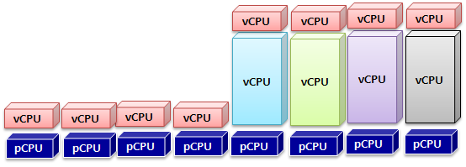
Evaluation
Workload consolidation
One 8-vCPU VM + four 1-vCPU VMs (x264)
Need coordination in time domain (~90% improvement)
Multiprocessor VMs
Balance scheduling degrades 1-vCPU VM by incurring unnecessary contention
Singleprocessor VMs

Slide 22
Summary
Contributions
Load-conscious balance scheduling
Essential for heterogeneously consolidated environments where load imbalance usually takes place
IPI-driven coordinated scheduling
Effective for VMM to alleviate unnecessary CPU contention based on IPIs between sibling vCPUs
Future work
Combining the “scheduling-based method” with “contention management methods”
Contention management methods
Paravirtual spinlock, HW-based spin detection

Slide 23
Virtual Asymmetric Multiprocessor for User-Interactive Performance
VM
User-Interactive
workload
Background workload
vCPU
vCPU
vCPU
vCPU
VMM
VMM scheduler
How to improve user-interactive performance mixed in multiprocessor VMs?
pCPU
pCPU
pCPU
pCPU

Slide 24

Motivation
Background & idea
The initial proposal of “Task-aware scheduling” did not consider multiprocessor VMs
Existing VMM schedulers give an illusion of symmetric multiprocessor (SMP) to each VM
Due to the absence of mixed workload tracking
The size of vCPU =
The amount of CPU shares
Virtual SMP (vSMP)
Virtual AMP (vAMP)
VM
VM
Interactive
Interactive
Background
Equally contended
regardless of
user interactions
Proposal
Background
vCPU
vCPU
vCPU
vCPU
vCPU
vCPU
Fast vCPUs
Slow vCPUs
Time
shared
vCPU
vCPU
vCPU
vCPU
vCPU
vCPU
vCPU
vCPU
vCPU
vCPU
vCPU
vCPU
pCPU
pCPU
pCPU
pCPU
pCPU
pCPU
pCPU
pCPU

Slide 25
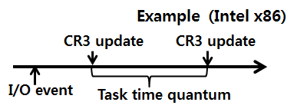
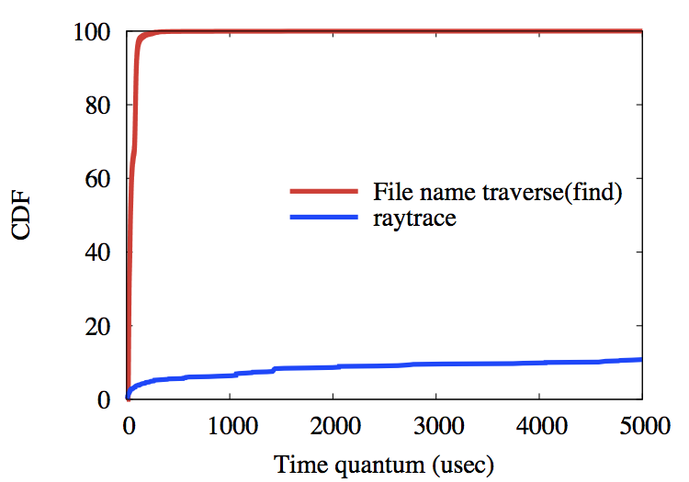
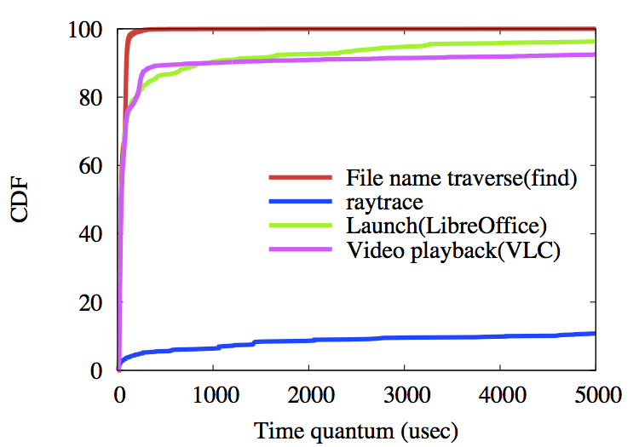
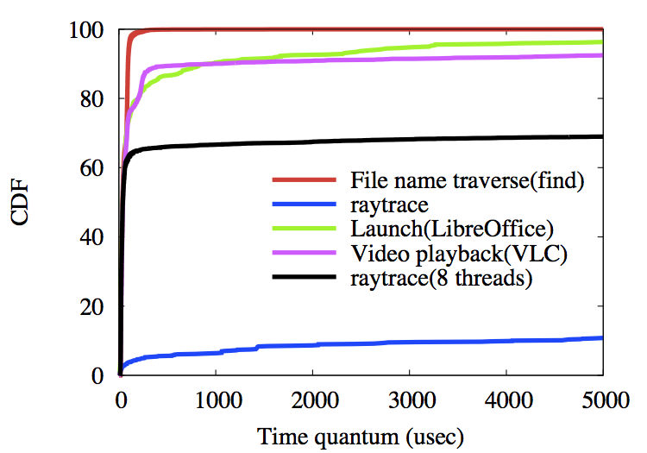
Workload Classification
Previous methods
Time-quanta based classification
“Interactive workloads typically show short time quantum”
OS technique: User I/O-driven IPC tracking [Zheng et al., SIGMETRICS’10]
+ Clear classification between
I/O-bound and CPU-bound tasks
- Modern interactive workloads
show mixed behaviors
- Multithreaded CPU-bound job
shows short time quanta due to
inter-thread communication
X server
IPC
Terminal
IPC
Firefox
User I/O
An interactive task group
+ Identifying a set of tasks involved in a user interaction (I/O)
- Relying on various OS-level IPC structures (e.g., socket, pipe, signal)
→ VMM cannot access OS-level IPCs

Slide 26
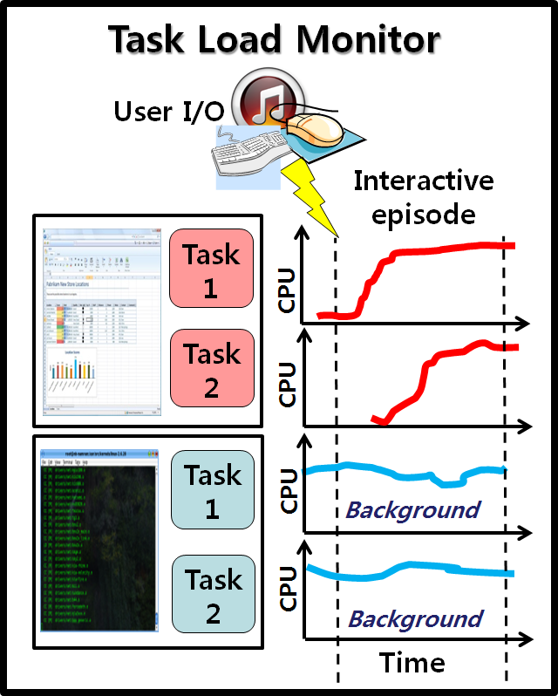
Workload Classification
Proposed scheme
“Background workload identification”
Instead of tracking interactive workloads,
Identifying “background CPU noise”
at the time of “user I/O”
Rationales
Interactive CPU load is typically initiated
by user I/O
VMM can unobtrusively monitor
user I/O and per-task CPU load
Exceptional case
Multimedia workloads (e.g., video playback)
Filtering multimedia tasks from background workloads
Tasks requesting audio I/O
Task Load Monitor
User input
Interactive phase
Task
1
CPU
Task
2
CPU
Task
1
CPU
Background
Task
2
CPU
Background
Time

Slide 27
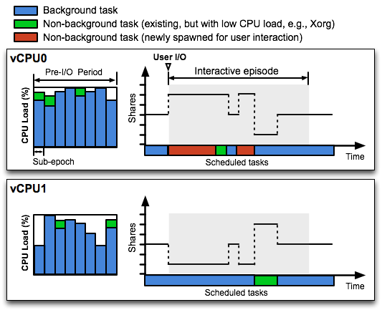
Virtual Asymmetric Multiprocessor
vAMP
Dynamically adjusting CPU shares of a vCPU according to its currently hosting task
2. Tagging tasks that
have generated
nontrivial CPU loads
as background tasks
→ Threshold can be
set to filter daemon tasks
that possibly serve
interactive workloads
1. Maintaining
per-task CPU load
during pre-I/O period
→ Pre-I/O period is
set to shorter than
general user think time
(1 second by default)
3. Dynamically adjusting
vCPU’s shares based on
weight ratio
(e.g., background :
non-background
= 1:5)
4. Providing vAMP
during an interactive
episode
→ An interactive episode
is restarted when another user I/O occurs or is finished if maximum time is elapsed without user I/O

Slide 28
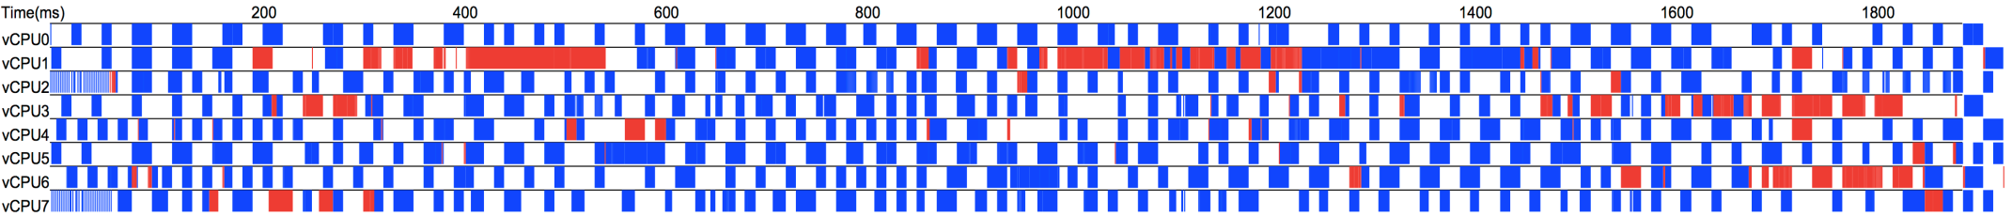
Limitation
An intrinsic limitation of VMM-only approach
Manipulating only a single scheduling layer (i.e., VMM scheduler)
A vAMP-oblivious OS scheduler
Agnostic about underlying vAMP (i.e., all vCPUs are identical)
Possibly multiplexing interactive and background tasks on the same vCPU
A slow vCPU has higher scheduling latency
“Frequent multiplexing” might offset the benefit of vAMP
Example: A scheduling trace during Google Chrome launch
Background task
Non-background task
“Aggressive weight ratio is not always effective if multiplexing frequently happens”
→ Weight ratio is an important parameter for interactive performance

Slide 29
Guest OS Extension
Guest OS extension for vAMP
OS enlightenment about vAMP
To avoid ineffective multiplexing of interactive and background tasks on the same vCPU → Isolation
Design principles
Keeping VMM OS-independent
Optional extension for further enhancement of interactive performance
Keeping extension OS-independent
No reliance on specific OS functionality
Isolating tasks on separate CPUs is a general interface of commodity OSes (e.g., modifying CPU affinity)
Small kernel changes for low maintenance cost

Slide 30
Guest OS Extension
Linux extension for vAMP
User-level vAMP-daemon
Isolating background tasks exposed by VMM from non-background tasks
Small kernel changes that expose background tasks to user
VM
_{User}
Isolation procedure:
1. Initially dedicating nr_fast_vcpus to interactive
tasks (i.e., non-background tasks)
2. Periodically increasing nr_fast_vcpus when
fast vCPUs become fully utilized
(also periodically checking the end of an interactive
episode → stop isolation)
Default nr_fast_vcpus = 1 due to the low
thread-level parallelism of interactive workloads
[Blake et al., ISCA’10]
_{vAMP-daemon}
3. Isolate
1. Event-
driven
2. Read
Input
interface
Kernel
Procfs
interface
T₃
T₄
Cpuset
interface
vCPU
vCPU
T₁
T₂
VMM
Task load monitor
vAMP scheduler
Background tasks
T₁, T₂

Slide 31
Evaluation
Application launch
Background workload
Data mining application (freqmine) with 8 threads
Weight ratio (background : non-background)
vAMP(L)=1:3, vAMP(M)=1:9, vAMP(H)=1:18
Remote desktop client
8-vCPU VM
8-vCPU VM
App
launch
freqmine
freqmine
8-pCPU
vAMP improves launch performance by 7~40%
High weight ratio is ineffective because of
negative effect of multiplexing
Why did Gimp show significant improvement
even without the guest OS extension?
Guest OS extension achieves further improvement
of interactive performance by up to 70%

Slide 32
Evaluation
Application launch
Chrome vs. Gimp (without guest OS extension)
Chrome (Web browser)
Background task
Non-background task
→ Many threads are cooperatively scheduled in a fine-grained manner
Gimp (Image editing program)
Background task
Non-background task
→ A single thread dominantly involves computation with little communication

Slide 33
Evaluation
Media player
VLC media player
1920x800 HD video with 23.976 frames per second (FPS)
Mult: multimedia workload filtering
8-vCPU VM
8-vCPU VM
Media player
freqmine
freqmine
8-pCPU
Without multimedia workload filtering,
VLC is misidentified as a background task
vAMP improves playback quality by up to 22.3 FPS,
but high weight ratio still degrades the quality
Guest OS extension achieves 23.8 FPS

Slide 34
Summary
vAMP
Dynamically varying vCPU performance based on their hosting workloads
A feasible method of improving interactive performance
Assisted by a simple guest OS extension
Isolation of different types of workloads enhances the effectiveness of vAMP
Future work
Collaboration of VMM and OSes for vAMP
Standard & well-defined API

Slide 35
Conclusions
Lessons learned from the thesis
In-depth analysis of OSes and workloads can realize intelligent CPU scheduling based only on VMM-visible events
Both lightweightness and efficiency are achieved
Task-awareness is an essential ability for VMM to effectively handle mixed workloads
Multi-tasking is ubiquitous inside every VM
Coordinated scheduling improves CPU efficiency of multiprocessor VMs
Resolving unnecessary CPU contention is crucial

Slide 36
Publications
Task-aware VM scheduling
[VEE’09] Hwanju Kim, Hyeontaek Lim, Jinkyu Jeong, Heeseung Jo, Joonwon Lee, “Task-aware Virtual Machine Scheduling for I/O Performance”
[JPDC’11] Hwanju Kim, Hyeontaek Lim, Jinkyu Jeong, Heeseung Jo, Joonwon Lee, Seungryoul Maeng, “Transparently Bridging Semantic Gap in CPU Management for Virtualized Environments”
[MMSys’12] Hwanju Kim, Jinkyu Jeong, Jaeho Hwang, Joonwon Lee, Seungryoul Maeng, “Scheduler Support for Video-oriented Multimedia on Client-side Virtualization”
[ApSys’12] Hwanju Kim, Sangwook Kim, Jinkyu Jeong, Joonwon Lee, and Seungryoul Maeng, “Virtual Asymmetric Multiprocessor for Interactive Performance of Consolidated Desktops”
Demand-based coordinated scheduling
[ASPLOS’13] Hwanju Kim, Sangwook Kim, Jinkyu Jeong, Joonwon Lee, and Seungryoul Maeng, “Demand-Based Coordinated Scheduling for SMP VMs”
Other work on virtualization
[IEEE TC’11] Hwanju Kim, Heeseung Jo, and Joonwon Lee, “XHive: Efficient Cooperative Caching for Virtual Machines”
[IEEE TC’10] Heeseung Jo, Hwanju Kim, Jae-Wan Jang, Joonwon Lee, and Seungryoul Maeng, “Transparent Fault Tolerance of Device Drivers for Virtual Machines”
[MICRO’10] Daehoon Kim, Hwanju Kim, and Jaehyuk Huh, “Virtual Snooping: Filtering Snoops in Virtualized Multi-cores”
[VHPC’11] Sangwook Kim, Hwanju Kim, and Joonwon Lee, “Group-Based Memory Deduplication for Virtualized Clouds”
[Euro-Par’08] Dongsung Kim, Hwanju Kim, Myeongjae Jeon, Euiseong Seo, Joonwon Lee, “Guest-Aware Priority-based Virtual Machine Scheduling for Highly Consolidated Server”
[VHPC’09] Heeseung Jo, Youngjin Kwon, Hwanju Kim, Euiseong Seo, Joonwon Lee, Seungryoul Maeng, “SSD-HDD-Hybrid Virtual Disk in Consolidated Environments”
Other work on embedded and mobile systems
[ACM TECS’12] Jinkyu Jeong, Hwanju Kim, Jeaho Hwang, Joonwon Lee, and Seungryoul Maeng, “Rigorous Rental Memory Management for Embedded Systems”
[CASES’12] Jinkyu Jeong, Hwanju Kim, Jeaho Hwang, Joonwon Lee, and Seungryoul Maeng, “DaaC: Device-reserved Memory as an Eviction-based File Cache”
[IEEE TCE’09] Heeseung Jo, Hwanju Kim, Hyun-Gul Roh, Joonwon Lee, “Improving the Startup Time of Digital TV”
[IEEE TCE’09] Heeseung Jo, Hwanju Kim, Jinkyu Jeong, Joonwon Lee, and Seungryoul Maeng, “Optimizing the Startup Time of Embedded Systems: A Case Study of Digital TV”
[IEEE TCE’10] Jeaho Hwang, Jinkyu Jeong, Hwanju Kim, Jin-Soo Kim, and Joonwon Lee, “AppWatch: Detecting Kernel Bug for Protecting Consumer Electronics Applications”
[IEEE TCE’12] Jeaho Hwang, Jinkyu Jeong, Hwanju Kim, Jeonghwan Choi, and Joonwon Lee, “Compressed Memory Swap for QoS of Virtualized Embedded Systems”
[SPE’10] Jinkyu Jeong, Euiseong Seo, Jeonghwan Choi, Hwanju Kim, Heeseung Jo, and Joonwon Lee, “KAL: Kernel-assisted Non-invasive Memory Leak Tolerance with a General-purpose Memory Allocator”

Slide 37
Thank
You !

Slide 38
References
[Blake et al., ISCA’10] Evolution of thread-level parallelism in desktop applications
[Botelho’08] Virtual machines per server, a viable metric for hardware selection? (http://itknowledgeexchange.techtarget.com/server-farm/virtual-machines-per-server-a-viable-metric-for-hardware-selection/)
[Govindan et al., VEE’07] Xen and co.: communication-aware CPU scheduling for consolidated xen-based hosting platforms
[Hu et al., HPDC’10] I/O scheduling model of virtual machine based on multi-core dynamic partitioning
[Kim et al., EuroPar’08] Guest-Aware Priority-Based Virtual Machine Scheduling for Highly Consolidated Server
[Kim et al., VEE’09] Task-aware virtual machine scheduling for I/O performance
[Kim et al., JPDC’11] Transparently Bridging Semantic Gap in CPU Management for Virtualized Environments
[Lee et al., VEE’10] Supporting Soft Real-Time Tasks in the Xen Hypervisor
[Liao et al., ANCS’08] Software techniques to improve virtualized I/O performance on multi-core systems
[Lin et al., SC’05] VSched: Mixing Batch And Interactive Virtual Machines Using Periodic Real-time Scheduling
[Masrur et al., RTCSA’10] VM-Based Real-Time Services for Automotive Control Applications
[Ongaro et al., VEE’08] Scheduling I/O in virtual machine monitors
[Sukwong et al., EuroSys’11] Is co-scheduling too expensive for SMP VMs?
[Uhlig et al., VM’04] Towards scalable multiprocessor virtual machines
[VMware ESXi’10] VMware vSphere: The CPU Scheduler in VMware ESX 4.1
[VMware VDI] Enabling your end-to end virtualization solution. (http://www.vmware.com/solutions/partners/alliances/hp-vmware-customers.html)
[Weng et al., HPDC’11] Dynamic adaptive scheduling for virtual machines
[Weng et al., VEE’09] The hybrid scheduling framework for virtual machine systems
[Xia et al., ICPADS’09] PaS: A Preemption-aware Scheduling Interface for Improving Interactive Performance in Consolidated Virtual Machine Environment
[Zheng et al., SIGMETRICS’10] RSIO: automatic user interaction detection and scheduling

Slide 39
Extra Slides

Slide 40
Demand-Based Coordinated Scheduling for Multiprocessor VMs

Slide 41
Proportional-Share Scheduler
Proportional-share scheduler for SMP VMs
Common scheduler for commodity VMMs
Employed by KVM, Xen, VMware, etc.
VM’s shares (S) =
Total shares x (weight / total weight)
VCPU’s shares = S / # of active VCPUs
Active vCPU: Non-idle vCPU
e.g., 4-VCPU VM (S = 1024)
Single-threaded workload
Multi-threaded (programmed) workload
VCPU0
(1024)
VCPU0
(256)
VCPU1
(256)
VCPU2
(256)
VCPU3
(256)
Symmetric vCPUs
Existing schedulers view active vCPUs
as containers with identical power

Slide 42
Helping Lock
Spin-then-block lock [AMD, XenSummit’08]
Block after spin during a certain period
+ Reducing unnecessary spinning
- Still LHP and unnecessary spinning
- Profiling required to find a suitable spin threshold
- Kernel instrumentation
But, most popular paravirtualized approach for open-source kernel like Linux
Paravirt-spinlock for Xen Linux (mainline)
Paravirt-spinlock for KVM Linux (patch)

Slide 43
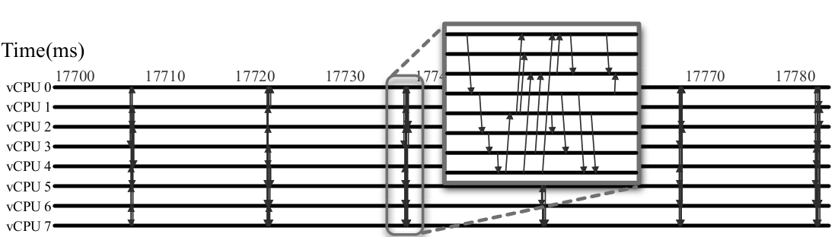
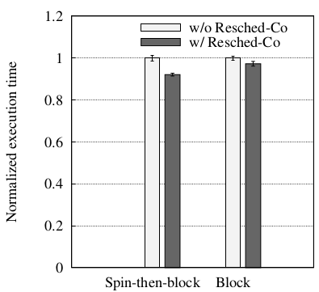
Coordination for User-level Contention
User-level synchronization
Pure spin-based synchronization is rarely used in user space
Block-based or spin-then-block synchronization
Reschedule IPI driven coscheduling
With regard to spin-then-block synchronization, less contention occurs by coscheduling cooperative threads
Reschedule IPI traffic of streamcluster
Streamcluster intensively uses spin-then-block barriers
Resched-Co alleviates spin-phase of lock wait time
Execution time of streamcluster
consolidated with bodytrack

Slide 44
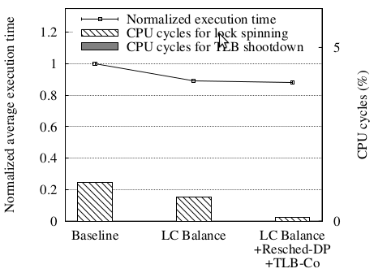
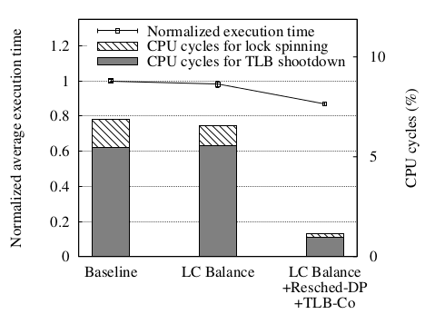
Performance on PLE
PLE (Pause-Loop-Exit)
A HW mechanism to notify VMM of spinning over a predefined threshold (i.e., pathological busy-waiting)
In response to this notification, VMM allows a currently running vCPU to yield its pCPU
Facesim (futex-intensive)
Ferret (TLB-IPI-intensive)
IPI-driven scheduling proactively alleviate unnecessary contention,
whereas PLE reactively relieves contention that has already happened

Slide 45
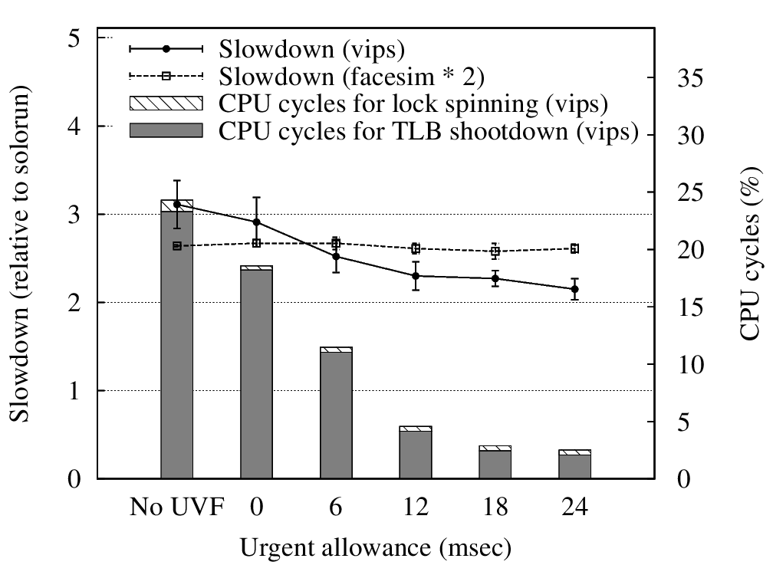
Evaluation: Urgent Allowance
Urgent allowance
Trading short-term fairness with CPU efficiency
How much short-term fairness is traded?
1 vips VM
+ 2 facesim VMs
Trading short-term fairness improves overall efficiency
without negative impact on long-term fairness

Slide 46
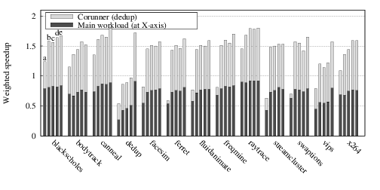
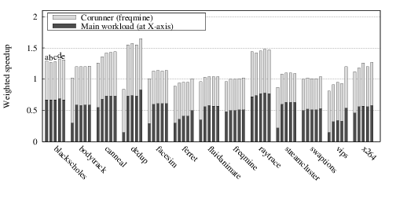
Evaluation: Two Multiprocessor VMs
w/ dedup
a: baseline
b: balance
c: LC-balance
d: LC-balance+Resched-DP
e: LC-balance+Resched-DP+TLB-Co
w/ freqmine

Slide 47
TLB Shootdown IPIs of Windows 7
Heavy use of TLB shootdown IPIs by Windows 7 desktop application launch
Most TLB shootdown IPIs are sent with multi/broadcasting
TLB-IPI-driven coscheduling improves PowerPoint launch time by 23% when consolidated with 4 VMs, each running streamclusters
Apps | Explorer | IE | PowerPoint | Word | Excel
# of triggers | 102 | 262 | 166 | 179 | 77
# of IPIs | 608 | 1230 | 782 | 990 | 418
Launch time (ms) | 622 | 982 | 975 | 1108 | 1011

Slide 48
Virtual Asymmetric Multiprocessor for User-Interactive Performance

Slide 49
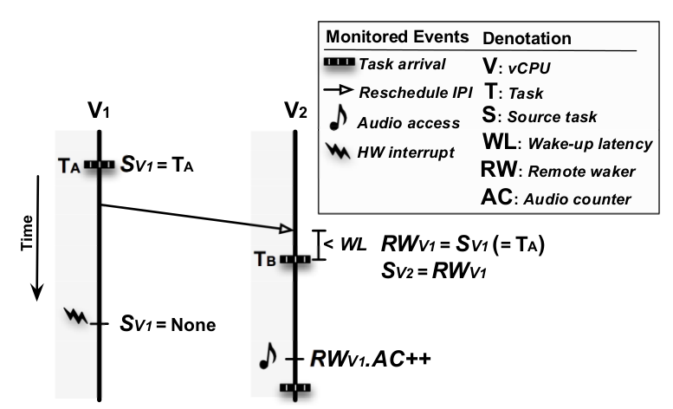
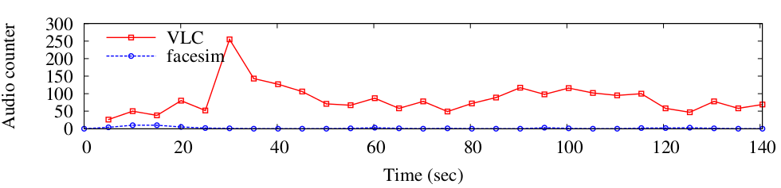
Multimedia Workload Filtering
Tracking audio-requesting tasks
Tracking tasks that access a virtual audio device
Excluding audio access in an interrupt context
Checking audio Interrupt Service Register (ISR)
Server-client sound system
A user-level task to serve all audio requests (e.g., pulseaudio)
Remote wake-up tracking
1VM: VLC+facesim
1VM: freqmine
(facesim severely interferes remote wake-up tracking)

Slide 50
Measurement Methodology
Spiceplay
Snapshot-based record/replay
Robust replay for varying loads
Similar to VNCPlay [USENIX’05] and Deskbench [IM’09]
Extension on the SPICE remote desktop client
Record
Snapshot at an input point → Input recording → Snapshot at a user-perceived point
Replay
Snapshot comparison & start timer → Input replaying → Snapshot comparison & stop timer

Slide 51
vAMP Parameters
Default vAMP parameters
Parameter | Role | Default value | Rationale
Background load threshold | Tagging background tasks | 50% | Large enough to filter general daemon tasks such as an X server
Maximum time of an interactive episode | Duration of distributing asymmetric CPU shares | 5sec | Large enough to cover a general interactive episode (2sec was used in previous research based on HCI work, but larger value is needed to cover long-launched applications )
Interactive episode is prematurely finished before the end of launch
Video playback:
vAMP(L) w/ Ext
Gimp launch:
vAMP(L) w/ Ext
X server is misclassified as
a background task

Slide 52
Evaluation: Background Performance
Performance of background workloads
With repeated launch with 1-second interval
Intensively interactive workloads
3-28% degradation

Slide 53
Evaluation: Guest OS Extension
Interrupt pinning
An interactive workload can accompany I/O
Even warm launch can involve synchronous disk writes
During an interactive episode, pinning I/O interrupts on fast vCPUs
In Linux, manipulate /proc/<irq number>/smp_affinity
If a disk I/O interrupt is delivered to a slow vCPU,
scheduling latency is increased
Chrome launch:
Chrome launch entails some synchronous writes

Slide 54
Evaluation: Guest OS Extension
nr_fast_vcpus parameter
Initial number of fast vCPUs
A workload with low thread-level parallelism is adversely
affected by multiple fast vCPUs, since unnecessary vCPU-level
scheduling latency is involved
Interactive workloads with low thread-level parallelism do not require
a large number of initial fast vCPUs

Slide 55
Task-aware VM Scheduling for I/O Performance

Slide 56
Problem of VM Scheduling
Task-agnostic scheduling
That event is mine
and I’m waiting for it
Run queue sorted based on CPU fairness
Head
Tail
VM1
VM2
I/O-bound task
Mixed task
CPU-bound
task
VMM
Your VM has low priority now!
I don’t even know this event is for your I/O-bound task!
Sorry not to schedule you immediately…
I/O event

Slide 57
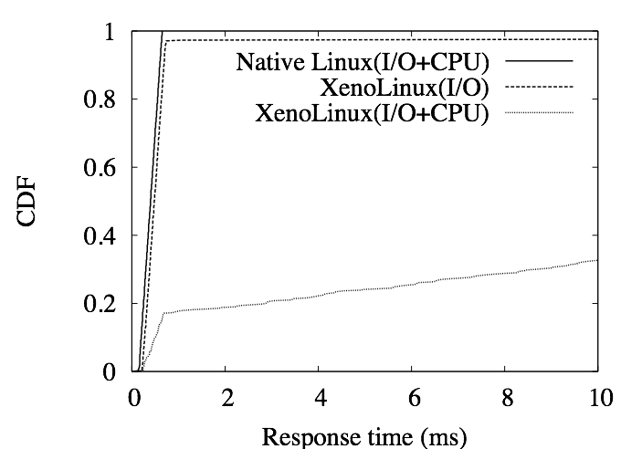
Task-agnostic scheduling
The worst case example for 6 consolidated VMs
Network response time
Native Linux: Non-consolidated OS
XenoLinux: Consolidated OS on Xen
<Workloads>
I/O+CPU
1 VM: Server & CPU-bound task
5 VMs: CPU-bound task
I/O
1 VM: Server
5 VMs: CPU-bound task
By boosting mechanism
of Xen Credit scheduler
Poor responsiveness
→ boosting mechanism realizes
I/O-boundness with only VCPU-level

Slide 58
Task-aware VM Scheduling
Goals
Tracking I/O-boundness with task granularity
Improving the response time of I/O-bound tasks
Keeping inter-VM fairness
Challenges
VM
VM
I/O-bound task
Mixed task
I/O-bound task
Mixed task
CPU-bound
task
CPU-bound
task
VMM
1. I/O-bound task identification
I/O event
2. I/O event correlation
3. Partial boosting
PCPU

Slide 59
Task-aware VM Scheduling 1. I/O-bound Task Identification
Observable information at the VMM
I/O events
Task switching events [Jones et al., USENIX’06]
CPU time quantum of each task
Inference based on common OS techniques
General OS techniques (Linux, Windows, FreeBSD, …) to infer and handle I/O-bound tasks
1. Small CPU time quantum (main)
2. Preemptive scheduling in response to I/O events (supportive)
Example (Intel x86)
CR3 update
CR3 update
I/O event
Task time quantum

Slide 60
Task-aware VM Scheduling 1. I/O-bound Task Identification
Three disjoint observation classes
Positive evidence
Support I/O-boundness
Negative evidence
Support non-I/O-boundness
Ambiguity
No evidence
Weighted evidence accumulation
Observation classes
Otherwise
Ambiguity
Positive
evidence
Negative
evidence
If 1 and 2 are satisfied
If 1 is violated
1. Small CPU time quantum (main)
2. Preemptive scheduling (supportive)
The degree
of belief
At this time, this task is believed as an I/O-bound task
More penalty for
long time quantum
# of sequential observations

Slide 61
Task-aware VM Scheduling 2. I/O Event Correlation
I/O event correlation
To distinguish an incoming event for I/O-bound tasks
Why?
To selectively prioritize I/O-bound tasks in a VM
CPU-bound tasks also conduct I/O operations
Goal
Best-effort correlation
Lightweight rather than accuracy
I/O types
Block I/O: disk read
Network I/O: packet reception

Slide 62
Task-aware VM Scheduling 2. I/O Event Correlation: Block I/O
Request-response correlation
Window-based correlation
Correlation for delayed read events by guest OS
e.g., block I/O scheduler
Overhead per VCPU = window size x 4bytes (task ID)
Inspection window
Any I/O-bound task in the window
user
T1
T2
T3
T4
kernel
read
VMM
Actual
read request

Slide 63
Task-aware VM Scheduling 2. I/O Event Correlation: Network I/O
History-based prediction
Asynchronous packet reception
Monitoring “the firstly woken task” in response to an incoming packet
N-bit saturating counter for each destination port number
Example: 2-bit counter
00
Non-
I/O-bound
01
Weak I/O-bound
Portmap
If the firstly woken task is I/O-bound
Destination
port number
Otherwise
10
I/O-bound
11
Strong I/O-bound
If portmap counter’s MSB is set,
this packet is for I/O-bound tasks
Overhead per VM = N x 8KB

Slide 64
Task-aware VM Scheduling 3. Partial Boosting
Priority boosting with task-level granularity
Borrowing future time slice to promptly handle an incoming I/O event as long as fairness is kept
Partial boosting lasts during the run of I/O-bound tasks
Run queue sorted based on CPU fairness
Head
Tail
VM1
VM2
VM3
I/O-bound task
CPU-bound
task
CPU-bound
task
VMM
If this I/O event is destined for VM3 and
is inferred to be handled by its I/O-bound task,
Initiate partial boosting for VM3 VCPU
I/O event

Slide 65
Evaluation (1/4)
Implementation on Xen 3.2
Experimental setup
Intel Pentium D for Linux (single core enabled)
Intel Q6600 (VT-x) for Windows XP (single core enabled)
Correlation parameters
Chosen for >90% accuracy and low overheads by stressful tests with synthetic workloads
Block I/O: Inspection window size = 3
Network I/O: Portmap bit width = 2

Slide 66
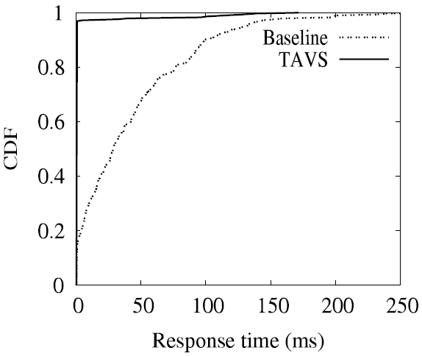
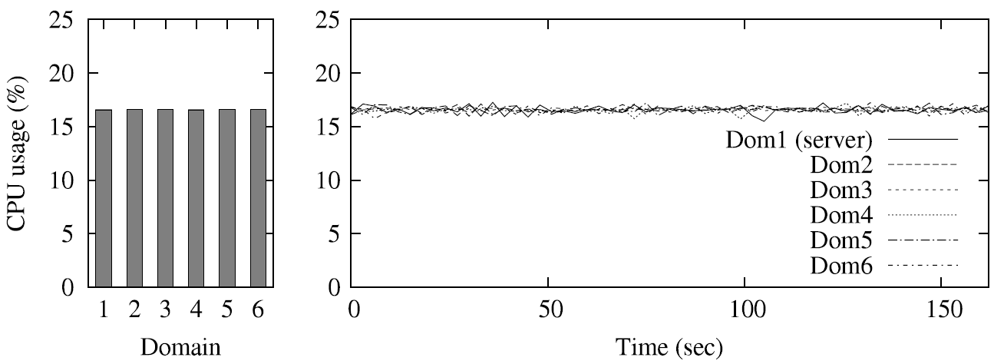
Evaluation (2/4)
Network response time
<Schedulers>
Baseline = Xen Credit scheduler
TAVS = Task-aware VM scheduler
<Workloads>
1 VM: Server & CPU-bound task
5 VMs: CPU-bound task
Response time improvement
Fairness guarantee

Slide 67
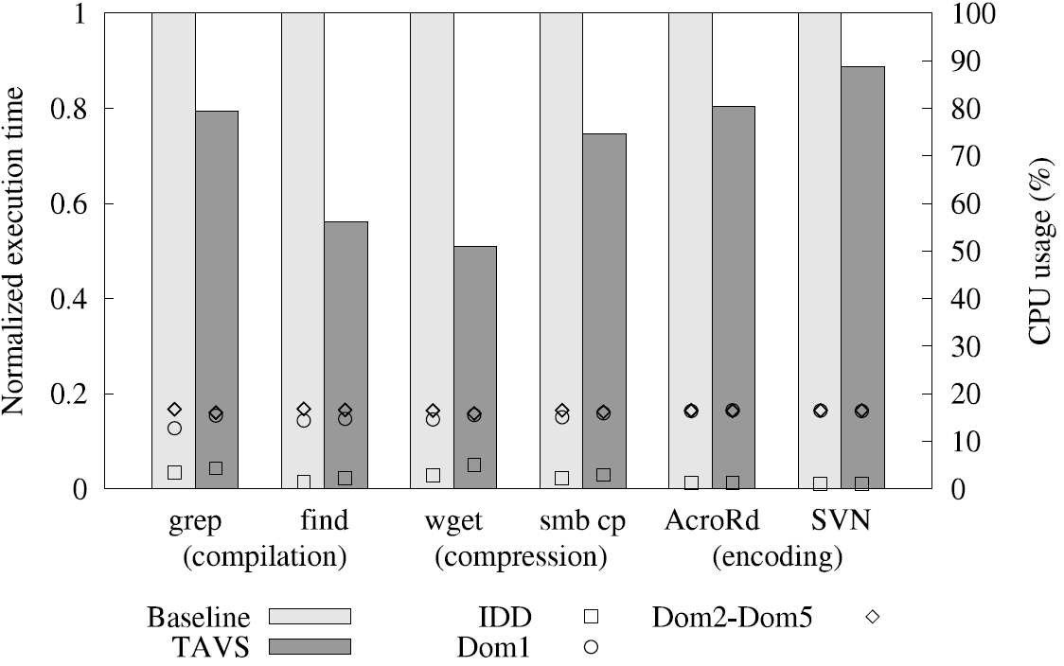
Evaluation (3/4)
Real workloads
<Workloads>
1 VM: I/O-bound & CPU-bound task
5 VMs: CPU-bound task
Ubuntu Linux
Windows XP
I/O-bound
tasks
CPU-bound
tasks
12-50% I/O performance
improvement with
inter-VM fairness

Slide 68
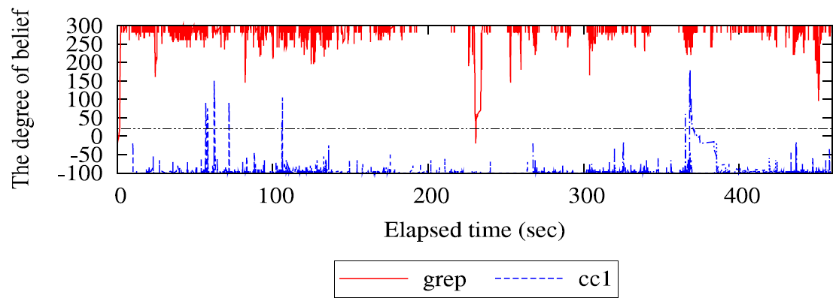
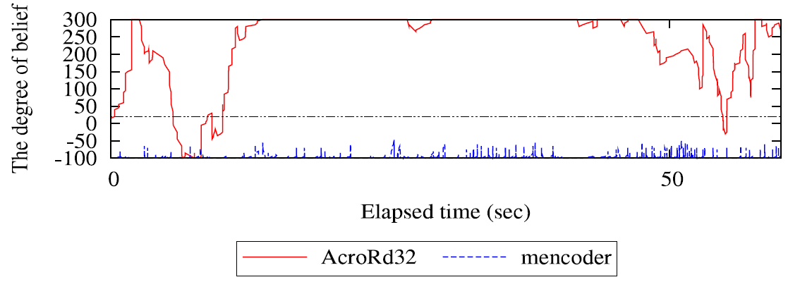
Evaluation (4/4)
I/O-bound task identification

Slide 69
Client-side Scheduler Support for Multimedia Workloads

Slide 70








Client-side Virtualization
Multiple OS instances on a local device
Primary use cases
Different OSes for application compatibility
Consolidating business and personal
computing environments on a single device
BYOD: Bring Your Own Device
Managed
domain
Business
VM
Personal
VM
Hypervisor

Slide 71
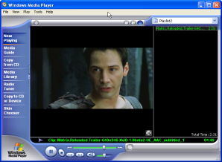

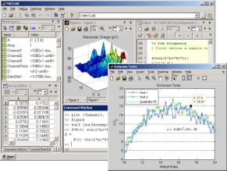
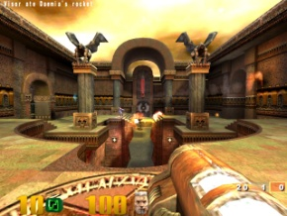

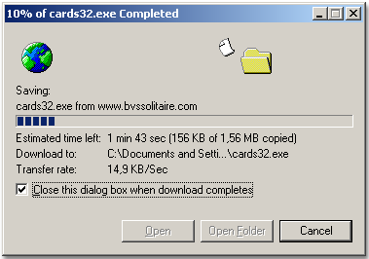
Multimedia on Virtualized Clients
Multimedia is ubiquitous on any VM
Video
Playback
Data
Processing
Video
conference
Compilation
3D game
Downloading
Windows
VM
Linux
VM
Business
VM
Personal
VM
Business
VM
Personal
VM
Hypervisor
Hypervisor
Hypervisor
1. Multimedia workloads are dominant on virtualized clients
2. Interactive systems can have concurrently mixed workloads

Slide 72
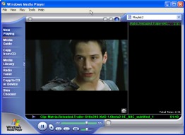

Issues on Multi-layer Scheduling
A multimedia-agnostic hypervisor invalidates OS policies for multimedia
VM
VM
Larger CPU proportion
& Timely dispatching
Task
Task
Task
Task
OS
scheduler
OS
Scheduler
Task
Task
Virtual CPU
Virtual CPU
BVT [SOSP’99]
SMART [TOCS’03]
Rialto [SOSP’97]
BEST [MMCN’02]
HuC [TOMCCAP’06]
Redline [OSDI’08]
RSIO [SIGMETRICS’10]
Windows MMCSS
OS scheduler
Additional
abstraction
Hypervisor
Scheduler
CPU
CPU
I’m unaware of any multimedia-specific OS policies in a VM, since I see each VM as a black box.
Semantic gap!

Slide 73




Multimedia-agnostic Hypervisor
Multimedia QoS degradation
Two VMs with equal CPU shares
Multimedia VM + Competing VM
Video playback
or 3D game
Competing
workloads
VM
VM
Xen hypervisor
Credit scheduler
Video playback (720p)
on VLC media player
Quake III Arena (demo1)

Slide 74

Possible Solutions to Semantic Gap
Explicit vs. Implicit
Explicit
OS cooperation
Explicit
User involvement
Implicit
Hypervisor-only
VM
VM
VM
OS scheduler
OS scheduler
OS scheduler
Workload monitor
Hypervisor
Scheduler
Hypervisor
Scheduler
Hypervisor
Scheduler
+ Accurate
- OS modification
- Infeasible w/o
multimedia-friendly
OS schedulers
+ Simple
- Inconvenient
- Unsuitable for
dynamic workloads
+ Transparency
- Difficult to identify
workload demands
at the hypervisor

Slide 75

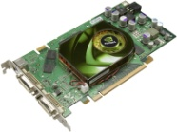
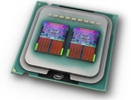
Proposed Approach
Multimedia-aware hypervisor scheduler
Transparent scheduler support for multimedia
No modifications to upper layer SW (OS & apps)
“Feedback-driven VM scheduling”
VM
VM
VM
Scheduling command
(e.g., CPU share or priority)
Hypervisor
Multimedia
monitor
Multimedia
manager
(feedback-driven)
CPU
scheduler
Estimated
multimedia QoS
Challenges
1. How to estimate multimedia QoS
based on a small set of HW events?
2. How to control CPU scheduler
based on the estimated information
Audio
Video
CPU

Slide 76


Multimedia QoS Estimation
What is estimated as multimedia QoS?
“Display rate” (i.e., frame rate)
Used by HuC scheduler [TOMCCAP’06]
How is a display rate captured at the
hypervisor?
Two types of display
Memory-mapped
display
(e.g., video playback)
2. GPU-accelerated
display
(e.g., 3D game)
Display
interface
Graphics
Library
Memory-mapped
Framebuffer
Acceleration unit
Video device

Slide 77

Memory-mapped Display (1/2)
How to estimate a display update rate on the memory-mapped framebuffer
Write-protection for virtual address space
mapped to framebuffer
Display interface
write
The hypervisor can inspect any attempt to map memory
Virtual address space
Hypervisor
page fault handler
{
Update display rate
}
Write-protection
Framebuffer
memory
Sampling to reduce trap overheads
(1/128 pages, by default)

Slide 78
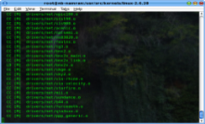
Memory-mapped Display (2/2)
Accurate estimation
Maintaining display rate per task
An aggregated display rate does not
represent multimedia QoS
Tracking guest OS task at the hypervisor
Inspecting address space switches (Antfarm [USENIX’06])
Monitoring audio access (RSIO [SIGMETRIC’10])
Inspecting audio buffer access with write-protection
A task with a high display rate and audio access
→ a multimedia task
Task
Task
10 FPS
25 FPS

Slide 79
GPU-accelerated Display (1/2)
Naïve method
Inspecting GPU command buffer with write-protection or polling
Too heavy due to huge amount of GPU commands
Lightweight method
Little overhead, but less accuracy
3D games are less sensitive to frame rate degradation than video playback
GPU interrupt-based estimation
An interrupt is typically used for an application to manage buffer memory
Hypothesis
“A GPU interrupt rate is in proportion to a display rate”

Slide 80
GPU-accelerated Display (2/2)
Linear relationship between display rates and GPU interrupt rates
Exponential weighted moving average (EWMA) is used to reduce fluctuation
EWMA_{t} = (1-w) x EWMA_{t-1} + w x current value
Intel GMA 950
(Apple MacBook)
Nvidia 6150 Go
(HP Pavillion tablet)
PowerVR
(Samsung GalaxyS)
A GPU interrupt rate can be used to estimate a display rate
without additional overheads

Slide 81
Multimedia Manager
A feedback-driven CPU allocator
Base assumption
“Additional CPU share (or higher priority) improves a display rate”
Desired frame rate (DFR)
A currently achievable display rate
Multiplied by tolerable ratio (0.8)
/* Exceptional cases:
* 1) No relationship between CPU and FPS
* 2) FPS is saturated below DFR
* 3) Local CPU contention in a VM
*/
If no FPS improvement by CPU share increase (3 times) Then
Decrease CPU share by half
IF current FPS < previous FPS AND
current FPS < DFR THEN
Increase CPU share
If in initial phase Then
Exponential increase
Else
Linear increase

Slide 82
Priority Boosting
Responsive dispatching
Problem
The hypervisor does not distinguish the types of events for priority boosting
A VM that will handle a multimedia event cannot preempt a currently running VM handling a normal event.
Higher priority for multimedia-related events
e.g., video, audio, one-shot timer
MMBOOST
IOBOOST
Normal priority
Multimedia events
Other events
Based on remaining CPU shares
Priority

Slide 83
Evaluation
Experimental environment
Intel MacBook with Intel GMA 950
Xen 3.4.0 with Ubuntu 8.04
Implementation based on Xen Credit scheduler
Two-VM scenario
One with direct I/O + one with indirect (hosted) I/O
Presenting the case of direct I/O in this talk
See the paper for the details of the indirect I/O case

Slide 84
Estimation Accuracy
Estimation accuracy
Error rates: 0.55%~3.05%
Video playback (720p)
(w/ CPU-bound VM)
multimedia manager disabled
Quake 3
(w/ CPU-bound VM)

Slide 85
Estimation Overhead
CPU overhead caused by page faults
Video playback
0.3~1% with sampling
Less than 5% with tracking all pages
Overhead | All pages | Sampling
 |  | 1/8 pages | 1/32 pages | 1/128 pages
Low resolution (640x354) | 4.95% | 1.10% | 0.54% | 0.58%
High resolution (1280x720) | 3.91% | 1.04% | 0.69% | 0.33%

Slide 86
Multimedia Manager
Video playback (720p) + CPU-bound VM

Slide 87
Performance Improvement
Performance improvement
Closed to maximum achievable
frame rates
Video playback
or 3D game
Competing
workloads
VM
VM
Hypervisor
Video playback (720p)
on VLC media player
Quake III Arena (demo1)

Slide 88
Limitations & Discussion
Network-streamed multimedia
Additional preemption support required for multimedia-related network packets
Multiple multimedia workloads in a VM
Multimedia manager algorithm should be refined to satisfy QoS of mixed multimedia workloads in the same VM
Adaptive management for SMP VMs
Adaptive vCPU allocation based on hosted multimedia workloads

Slide 89
Conclusions
Demands for multimedia-aware hypervisor
Multimedia are increasingly dominant in virtualized systems
“Multimedia-friendly hypervisor scheduler”
Transparent and lightweight multimedia support on client-side virtualization
Future directions
Multimedia for server-side VDI
Multicore extension for SMP VMs
Considerations for network-streamed multimedia

